Slide 1

LEARNFLOW
LEARNFLOW: AI-Powered Skill Platform
With Carrier Growth and Rewards
Unlock rewards while growing real-world skills
Team Falcon

Slide 2
Agenda
🚀 Mission and Vision
🔒 AI-Powered Proctoring
💻 Core Idea
📊 Skill & Profile Tracker
🎯 Key Features
📊 Skill & Profile Tracker
AI Learning Assistant
💻 Tech Stack

Slide 3




Mission and Vision
What we are and what we do

Slide 4

🚀 Mission and Vision
• Make learning engaging, rewarding, and career-driven
• Provide real incentives like swags, cash, internships, and mentors
• Promote fairness and competition with AI-powered testing

Slide 5

Mission Statement
Our mission is to harness cutting-edge technology to create innovative solutions that empower businesses and individuals. We are committed to excellence, quality, and delivering value to our stakeholders.

Slide 6




💻 Core Idea
Fundamental Beliefs and Principles

Slide 7
💻 Core Idea
• Gamified skill levels with increasing challenges
• AI assistant for learning via Text, Image, Diagram, or Video
• Anti-cheat AI for secure assessments
• Earn skill badges and real-world benefits

Slide 8
🎯 Key Features

Slide 9

🎯 Key Features
Level-Based Skill Challenges:
Real Rewards & Incentives:
Engage in progressively harder levels that test your skills and knowledge. Complete each level to unlock rewards and advance your learning journey.
Earn points redeemable for cash, T-shirts, company recommendations, internships, mentorships, and exclusive swag as you level up.
Secure AI Proctoring:
AI-Powered Learning Assistant:
Ask questions and get answers tailored to your preferred format — text, images, diagrams, or videos — for a personalized learning experience.
Prevent cheating with AI that monitors tab changes, checks webcam activity, and automatically closes tests if suspicious behavior is detected.
Skill & Profile Tracking:
Contests & Hackathons:
Automatically update your profile with skills earned from each completed level. Share your verified skill badges with recruiters and mentors.
Participate in live competitions to showcase your skills, climb leaderboards, and win exclusive prizes.

Slide 10
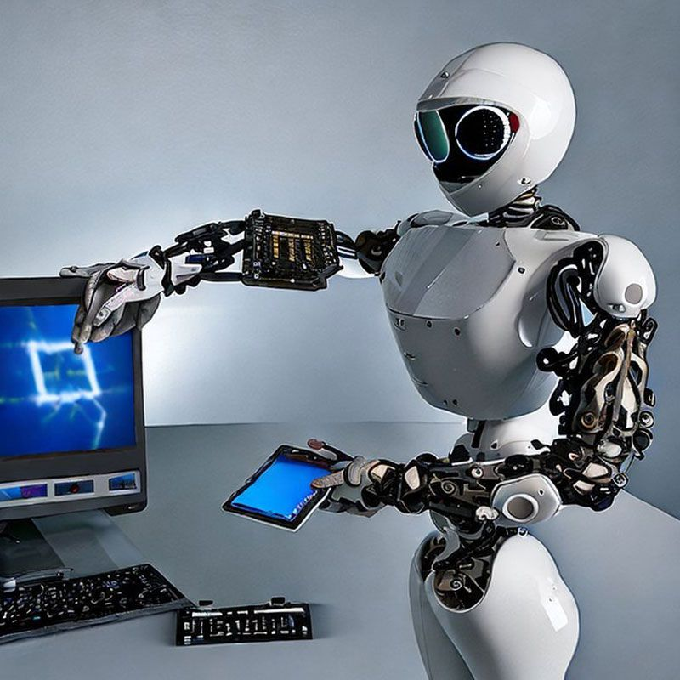
AI Learning Assistant

Slide 11
AI Learning Assistant
• Before answering, AI asks: Choose format → Text | Image | Diagram | Video
• Learners engage with AI in their preferred mode
• Better understanding, deeper learning

Slide 12




🔒 AI-Powered Proctoring

Slide 13


🔒 AI-Powered Proctoring
• Auto-close tab if user switches/focus lost
• Webcam checks: Close if phone or face mismatch
• Logs suspicious steps
• Secure, fair skill evaluation

Slide 14

📊 Skill & Profile Tracker

Slide 15
📊 Skill & Profile Tracker
• Every passed level auto-adds a new skill
• Public profile shows validated skill badges
• AI suggests learning & career paths

Slide 16





📈 Contests, Rankings, Referrals

Slide 17
📈 Contests, Rankings, Referrals
• Real-time Leaderboards for each skill
• Hackathons with rewards and recognition
• Refer friends, earn extra perks
• Collectable badges & achievements

Slide 18

💻 Tech Stack

Slide 19



💻 Tech Stack
• Frontend: React / Flutter / Python / Html / Css
• Backend: Node.js / Firebase / Python
• AI: GPT-4, Whisper, Vision Models
• Proctoring: OpenCV, MediaPipe, JS Listeners
•Prediction: Machinelearning, R , Power Bi

Slide 20

🔮 Future Roadmap

Slide 21

🔮 Future Roadmap
• University Integration & Campus Ambassadors
• Personalized AI Mentors
• Real-time career & job matching
• NFT-style badges for skills
• Global Skill Leaderboard
• Companies

Slide 22

Thank you
Let's Redefine Learning, Together 🚀

